Slide 1
Event Booking
Console C# project demo by Stilqn Gochev

Slide 2

Introduction
A simple console booking system that simulates a real-world platform. Focus on building business logic, menus, and user flows in C# OOP.
Shows how a structured program handles events, bookings, and seat tracking while keeping the interface text-based and clear.

Slide 3

01
Project Overview

Slide 4
Objectives
Build a structured C# application with clear class responsibilities.
Apply OOP principles (encapsulation, classes, methods) and handle user input, validation, and a repeatable booking workflow.

Slide 5
Core Features
Add, view, and manage events with live seat counts.
Book and cancel tickets, prevent overbooking, and navigate a menu-driven system. Emphasizes simple, testable logic and expandable design.

Slide 6

Example Flow
Start program and view the menu to browse events.
Select an event, enter ticket count, confirm booking, and see seats update.
Repeat actions or cancel bookings; return to menu until you exit. Keep interactions simple and predictable for testing.

Slide 7
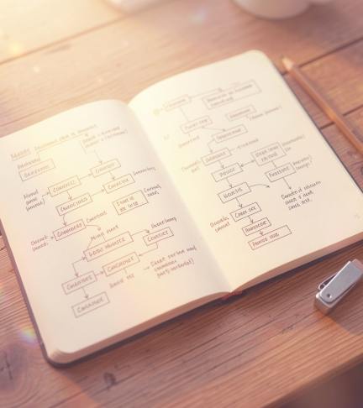
02
Technical Design

Slide 8
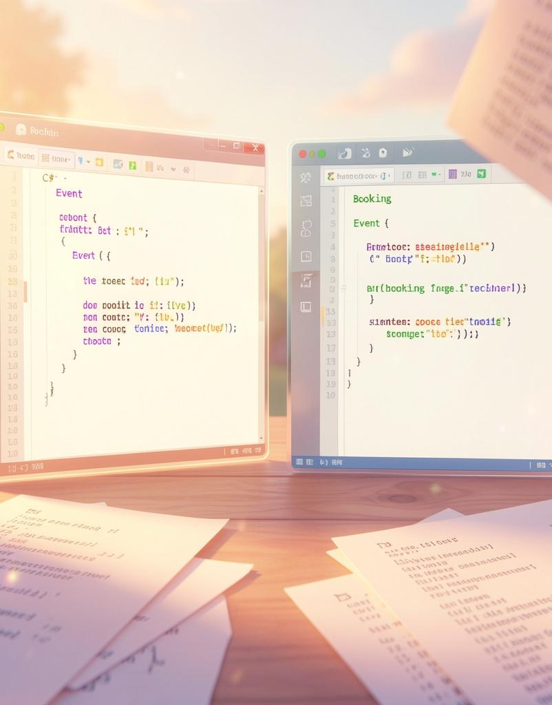
Classes & Data
Use an Event class (Name, Date, Location, AvailableSeats) and a Booking class (Event ref, Customer, Tickets).
Store events and bookings in lists for easy iteration and updates.
Controller handles menu logic and coordinates class interactions.

Slide 9
Validation & Errors
Check numeric inputs, ensure ticket requests dont exceed available seats, and verify selected events exist.
Handle wrong choices gracefully with friendly messages and no crashes.
Log or display simple error feedback for debugging and user clarity.

Slide 10
Conclusions
A compact console app that demonstrates C# and OOP fundamentals through a realistic booking flow.
Focuses on clean class design, input validation, and expandable features like GUI and database integration.
Great project for learning and extending into a full application.

Slide 11
Thanks for the attention!

